Slide 1


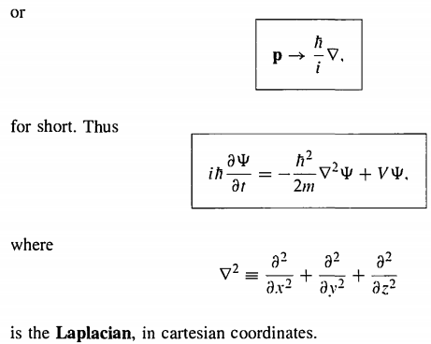

The generalization of QM mechanics is straightforward. The Schrodinger equation says
The Hamiltonian operator H is obtained from classical energy
$$H=T+V=\frac{1}{2}mv^{2}+V=\frac{1}{2m}\left(p_{x}^{2}+p_{y}^{2}+p_{z}^{2}\right)+V$$
Now,

Slide 2




The potential energy V and the wave function $Ψ$ are now functions of $r=\left(x,y,z\right)$ and t. The normalization condition is
The stationary state solution now looks
Where the spatial wave function $ψ_{n}$ satisfies the time-independent Schrodinger equation
(1)

Slide 3
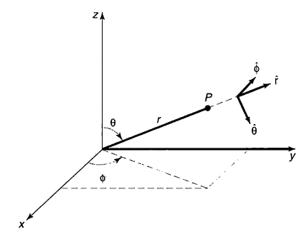
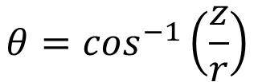





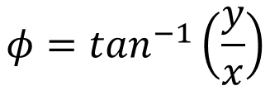
Schrodinger equation in spherical polar coordinates
$$(x,y,z)→(r,θ,φ)$$
$$x=r\sin\left(θ\right)cos⁡(φ)$$
$$y=r\sin\left(θ\right)sin⁡(φ)$$
$$z=r\cos\left(θ\right)$$
$$r=\sqrt{x^{2}+y^{2}+z^{2}}$$
$$θ=\cos^{−1}\left(\frac{z}{r}\right)$$
$$φ=\tan^{−1}\left(\frac{y}{x}\right)$$

Slide 4

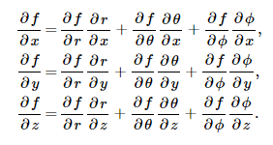
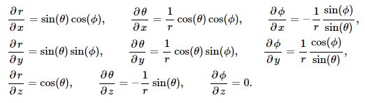


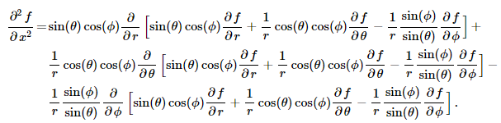

Slide 5



The Laplacian in spherical polar coordinates can have the form
The time-independent Schrodinger equation reads
(2)

Slide 6
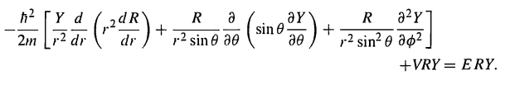
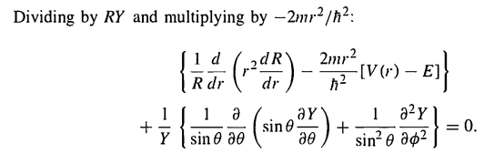
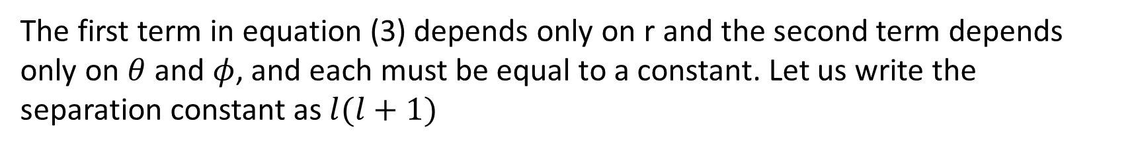
Equation (2) become
(3)
The first term in equation (3) depends only on r and the second term depends only on $θ$ and $φ$, and each must be equal to a constant. Let us write the separation constant as $l(l+1)$

Slide 7


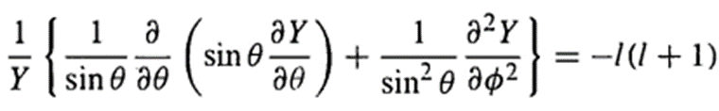

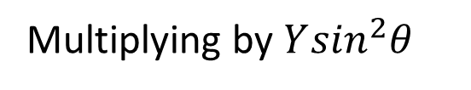
We have from equation (3)
(4)
(5)
Solution of the angular equation
Multiplying by $Y\sin^{2}θ$
(6)

Slide 8


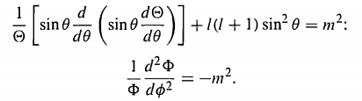
Use the separation of variable
Equation (6) become
(7)
The first term in equation (7) is a function of theta only and the 2nd term is a function of phi, so each must be a constant. This time we call this constant as $m^{2}.$
(8)
(9)

Slide 9


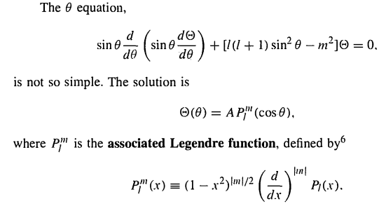
The equation (9) is easy to solve

Slide 10

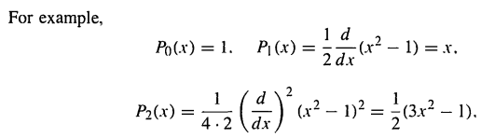
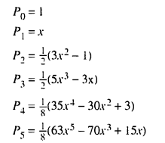
$P_{l}(x)$ is the Legendre Polynomial of order l, defined by the Rodrigues formula:

Slide 11
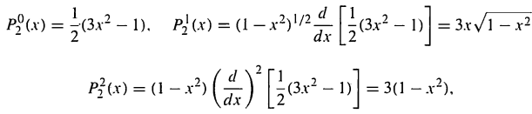
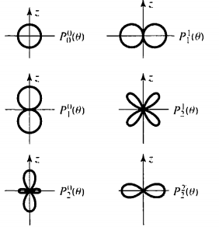
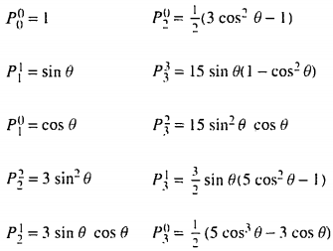

Slide 12


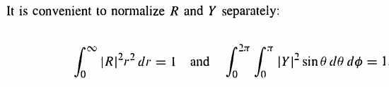
The normalization condition becomes

Slide 13
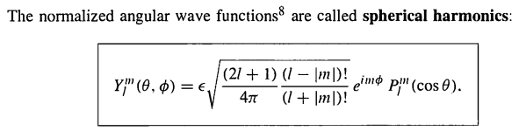
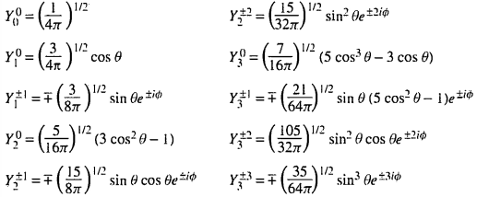

Slide 14
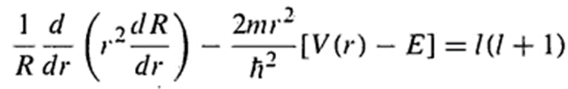



The Radial Equation
The radial part of the wavefunction is given by equation (4)
(4)
Which can be written as

Slide 15


So, the equation (4) can be written as
(10)
This is called the radial equation, it is identical to the one-dimensional Schrodinger equation with the effective potential

Slide 16
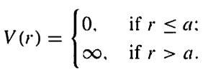
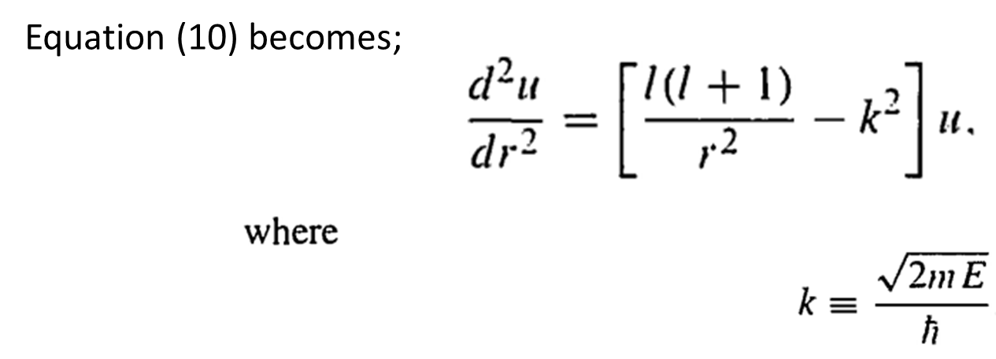
Consider the infinite square well potential
Outside the well, the wavefunction is zero, and inside the well

Slide 17
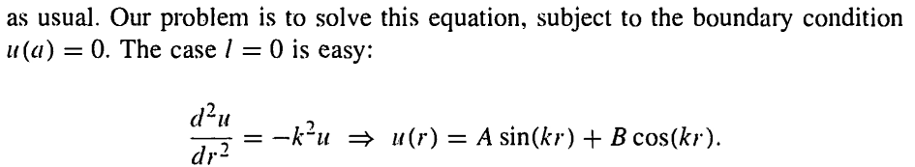


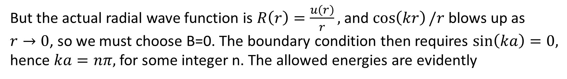
But the actual radial wave function is $R\left(r\right)=\frac{u\left(r\right)}{r},$ and $\cos\left(kr\right)/r$ blows up as
$r→0$, so we must choose B=0. The boundary condition then requires $\sin\left(ka\right)=0,$ hence $ka=nπ,$ for some integer n. The allowed energies are evidently
Normalizing u(r) yields $A=\sqrt{2/a}$ and the angular part for l=0 give
So, the final solution is,

Slide 18


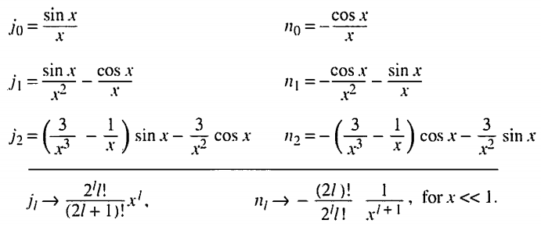
The general solution of equation (10) for arbitrary quantum number is

Slide 19
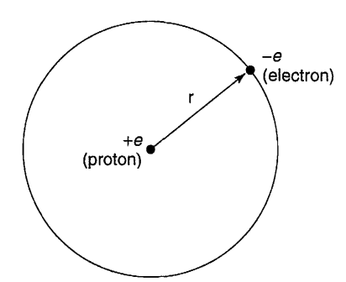



Hydrogen atom: one negatively charged electron is traveling around one positive charge proton. From Coulomb’s law the potential of the system is:
So, the radial equation (10) becomes
(11)
We need to solve the above equation (11) to find the energy level of the electron in the hydrogen atom.
Let

Slide 20

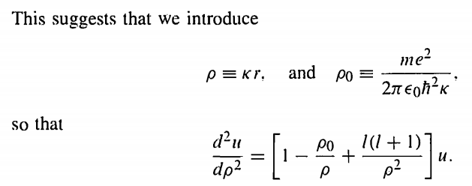
Dividing equation (11) by E and introducing k instead of E we have

Slide 21
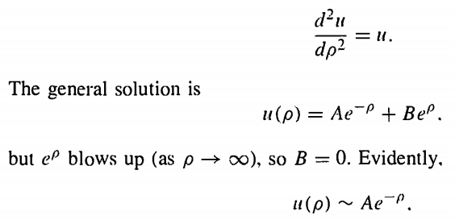

For $ρ→∞$ that is large distance from the nucleus
For $ρ→0$ that is very close to nucleus

Slide 22
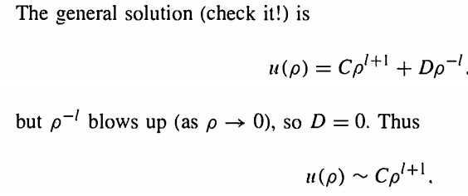


Now let us do the intermediate solution, let us introduce a new function $ν(ρ)$

Slide 23



So, the radial equation (11) becomes
(12)
Let us assume the solution of equation (12) as power series as follows

Slide 24


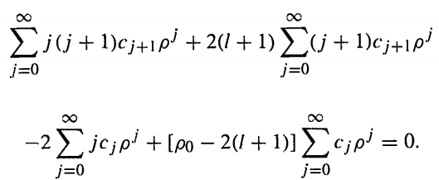
Inserting this in equation (12) yields

Slide 25
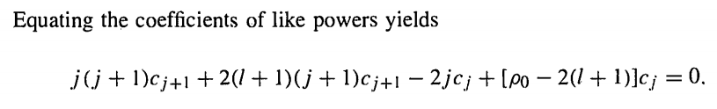
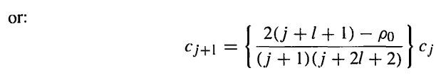
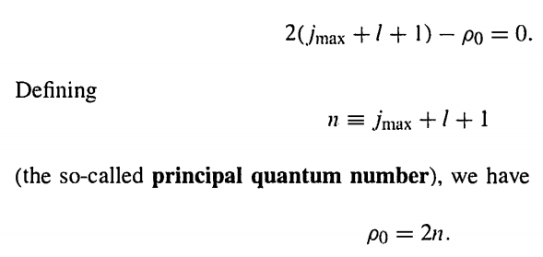
Eventually this becomes

Slide 26
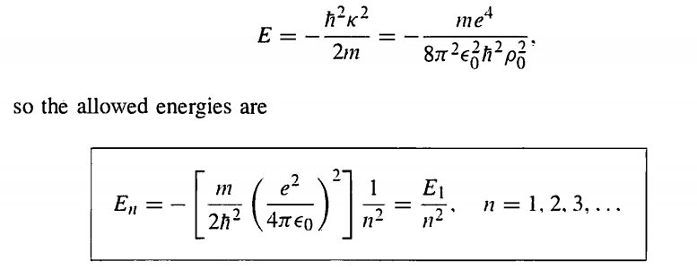
So, the energy E becomes
This is the famous Bohr formula for the energy level of the hydrogen atom

Slide 27


For the ground state energy n=1
The ground state wave function is

